Slide 1
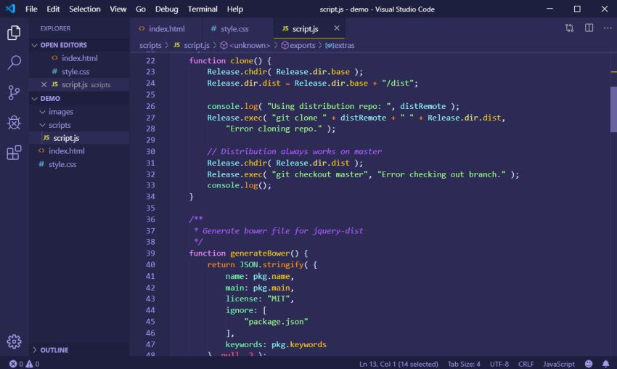
BPJS
KESEHATAN
PROJECT 2 GROUP 9
Flowchart
Pseudocode
Dry Run

Slide 2
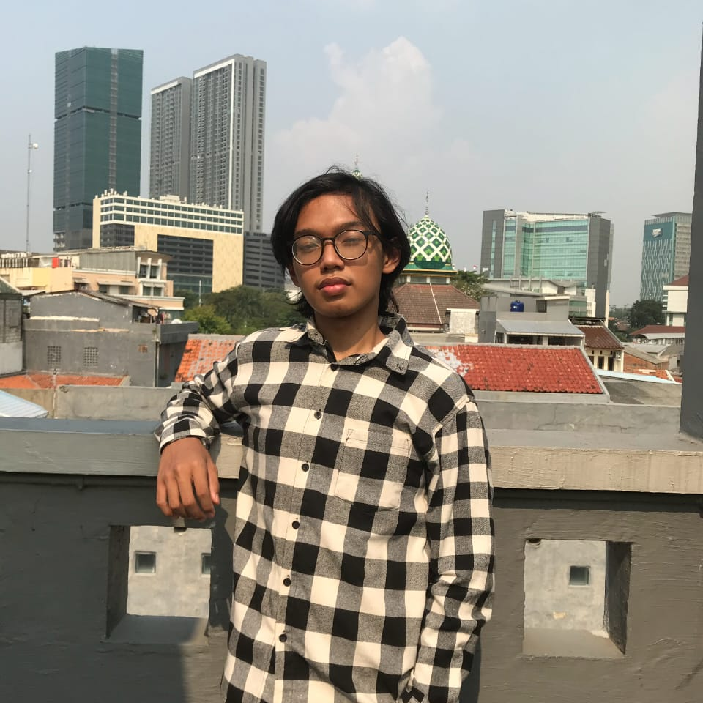
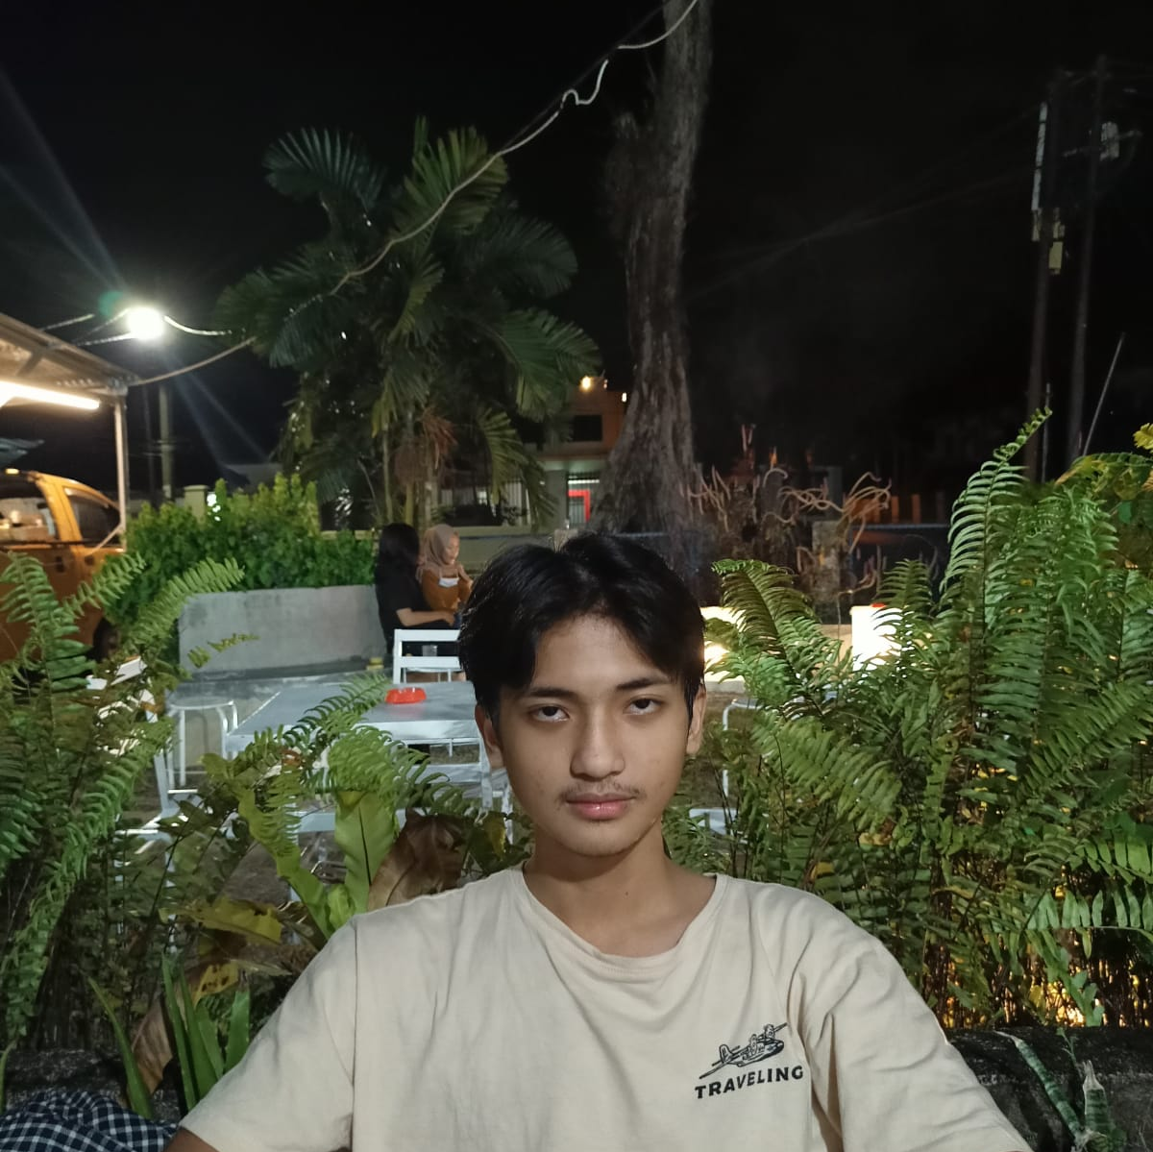
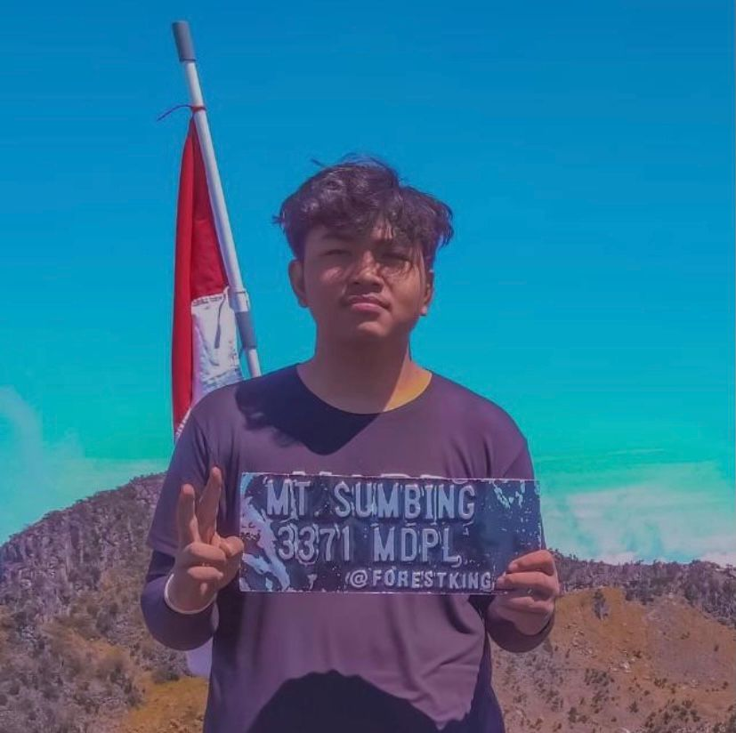
GROUP 4
BPJS KESEHATAN
Muhammad Zidan Satrio
Muhammad Daka Anugrah
Damar Wicaksono
IG : @muhammadzidansatrio
IG : @damarwicaksono123
IG : @dakaanugrah_

Slide 3

System
Summary
BPJS KESEHATAN
In this implementation of IT in ’BPJS KESEHATAN’, we plan a manufacture of flowchart , pseudocode and dry run.
So first of all we have to make a flowchart which is shown of our own concept and problems and then we translate the flow chart in pseudocode which an informal way of programming description that does not require any strict programming language syntax or underlying technology considerations. It is used for creating an outline or a rough draft of a program. Pseudocode summarizes a program's flow, but excludes underlying details.

Slide 4
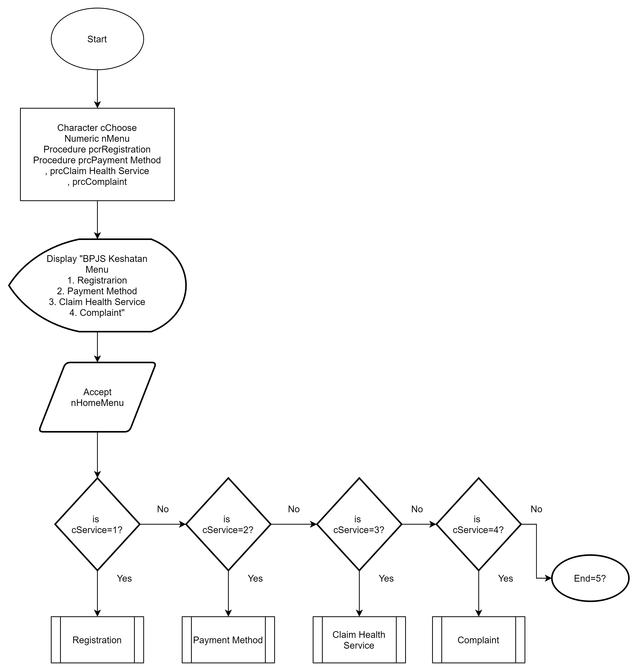
FLOWCHART HOME MENU

Slide 5
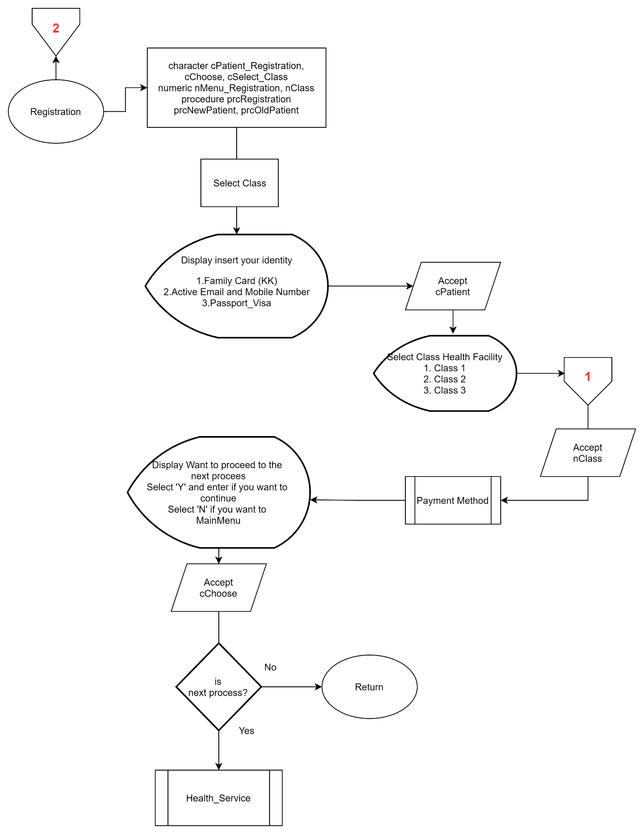
FLOWCHART REGISTRATION

Slide 6

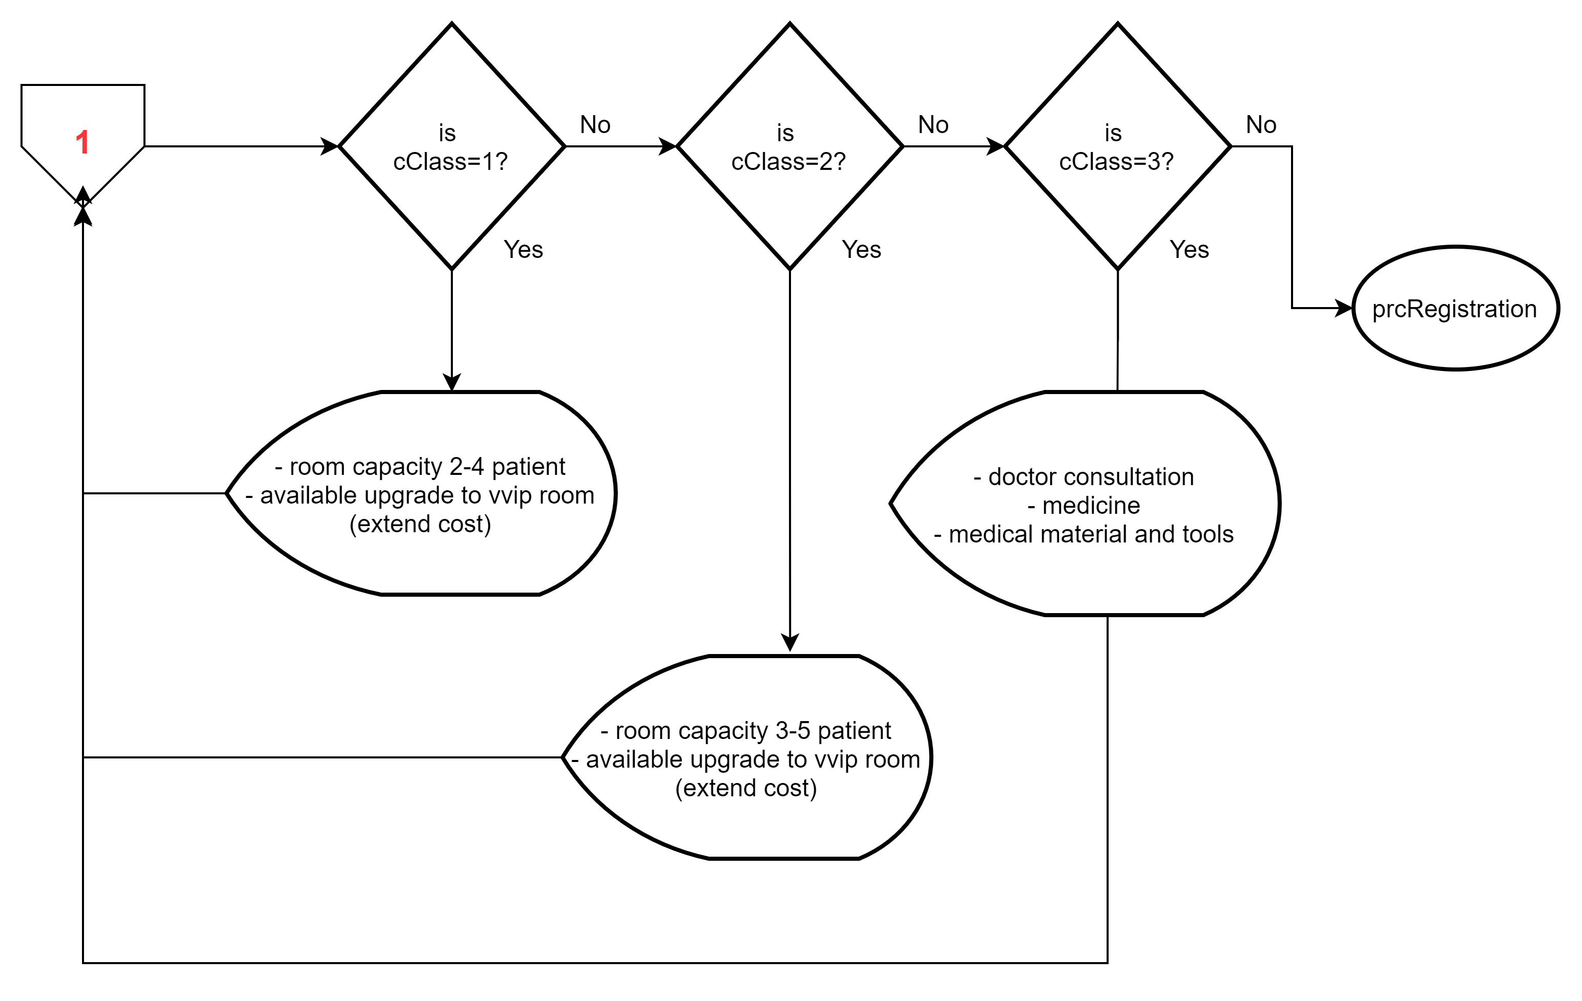
FLOWCHART SELECT CLASS

Slide 7
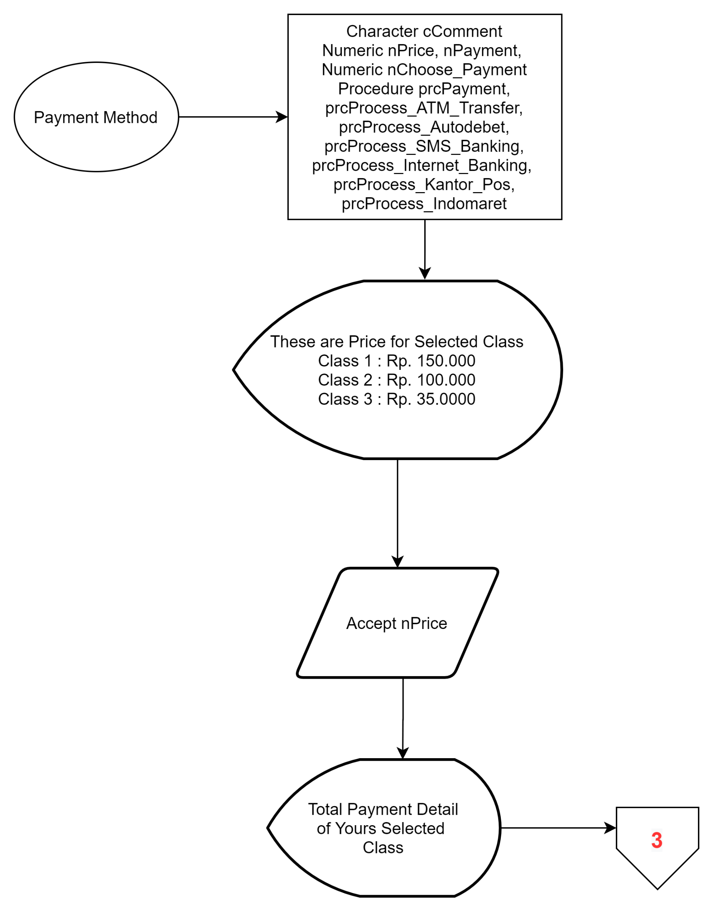
FLOWCHART PAYMENT METHOD

Slide 8
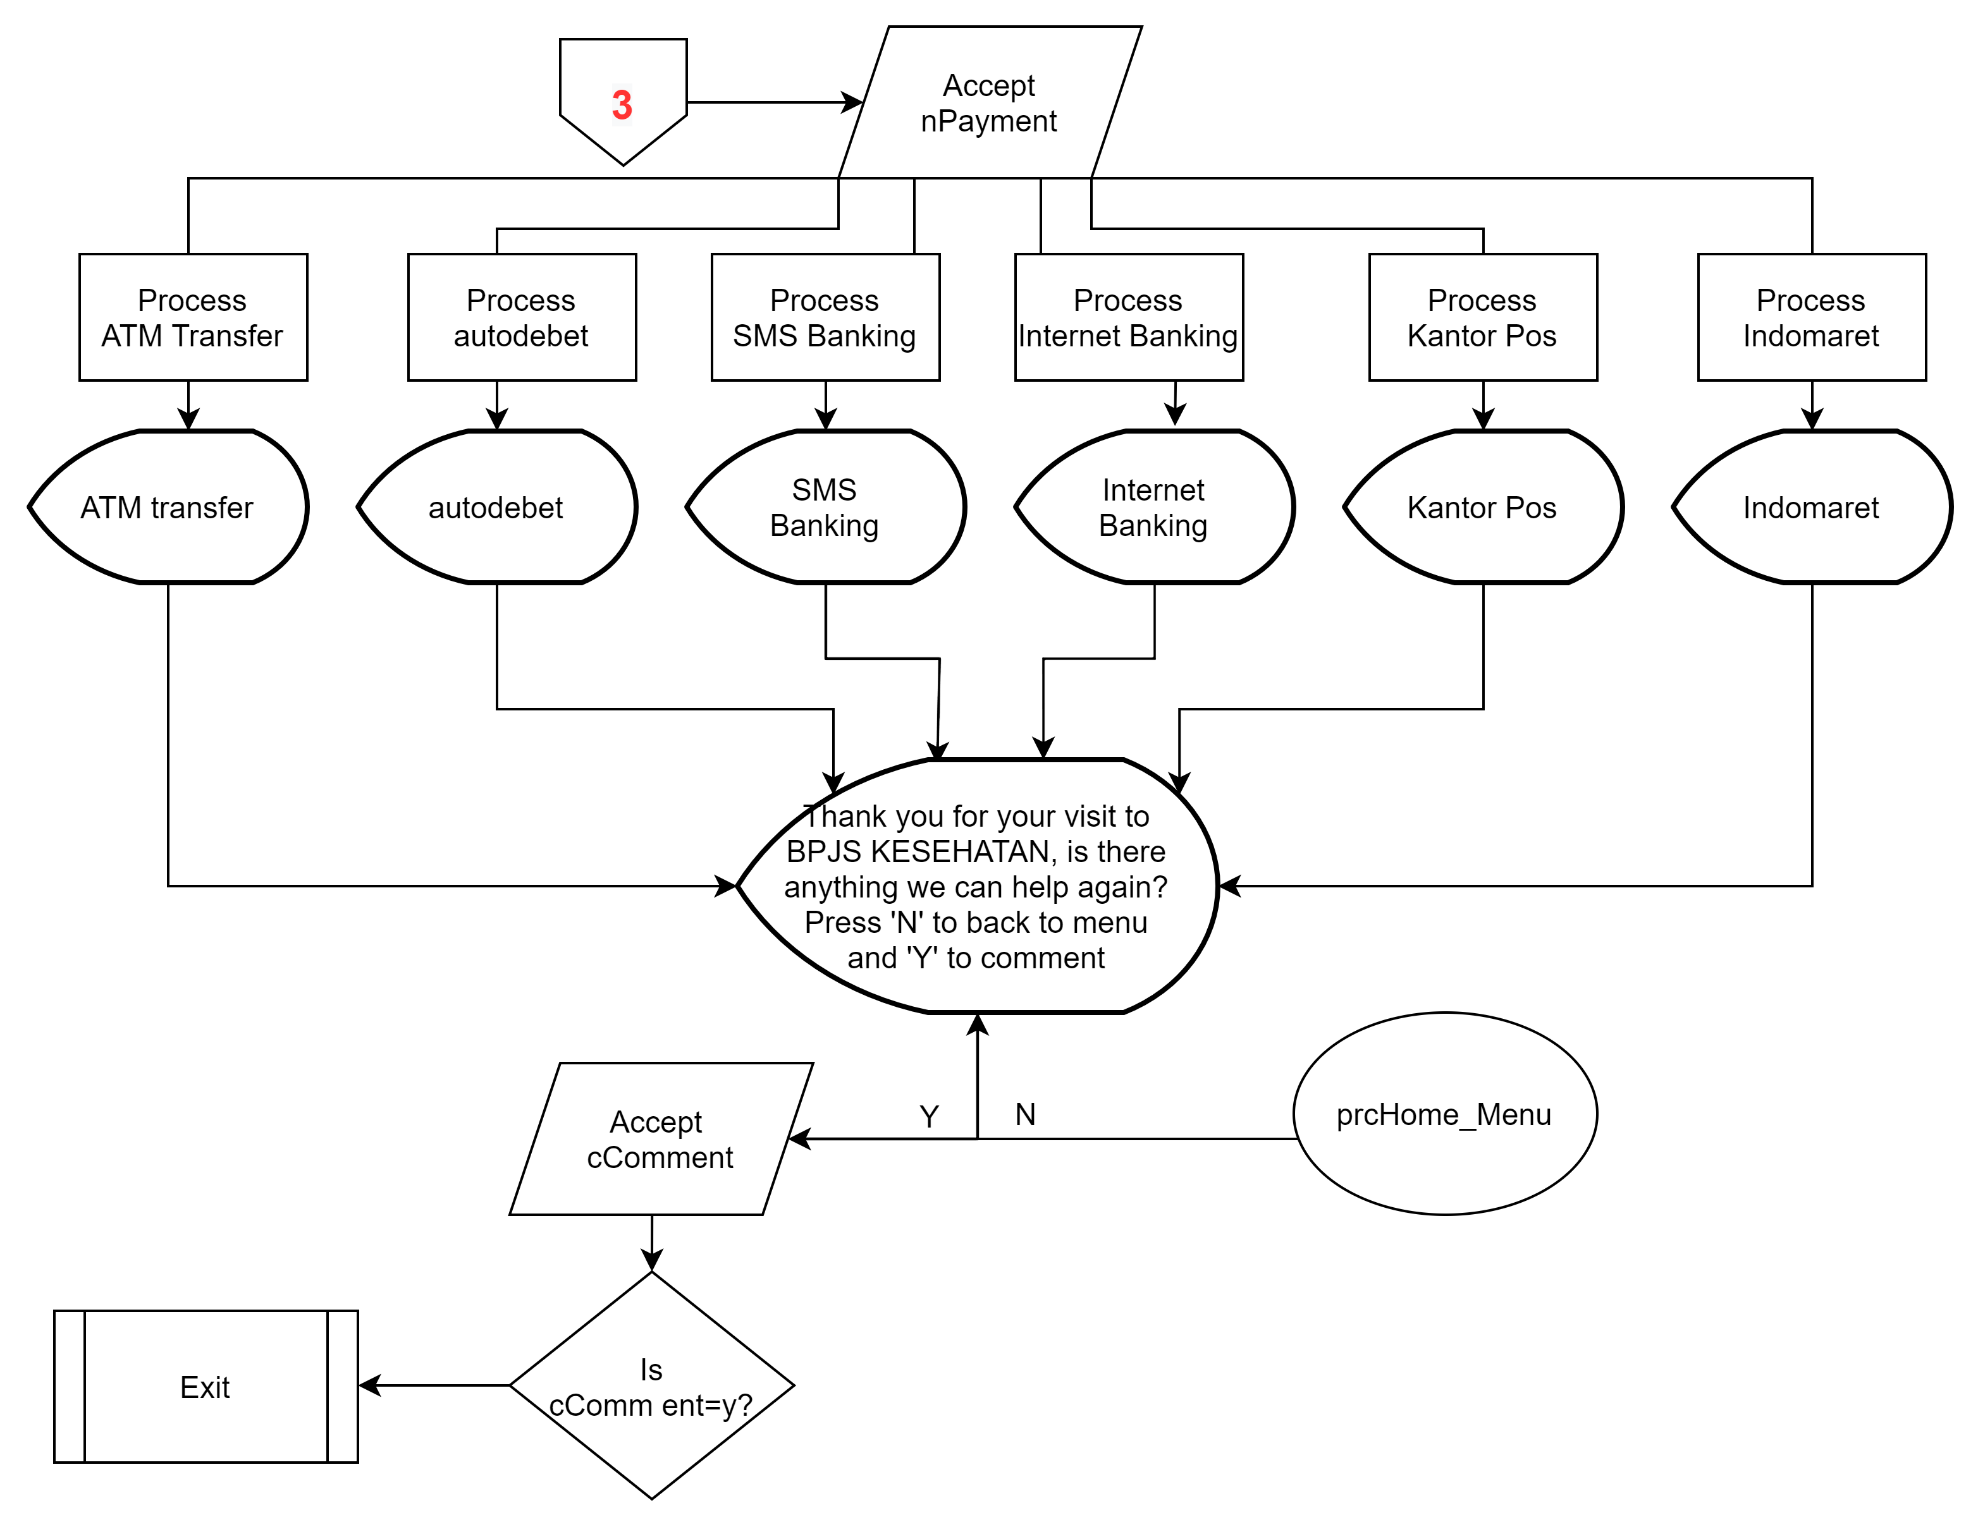
FLOWCHART PAYMENT METHOD

Slide 9
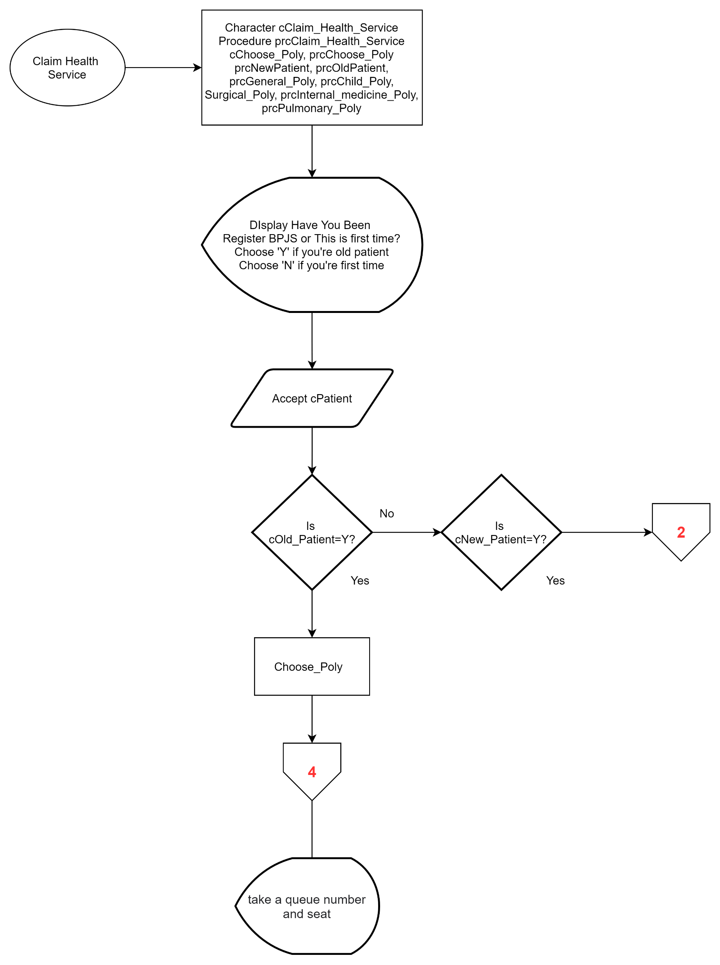
FLOWCHART CLAIM HEALTH SERVICE

Slide 10
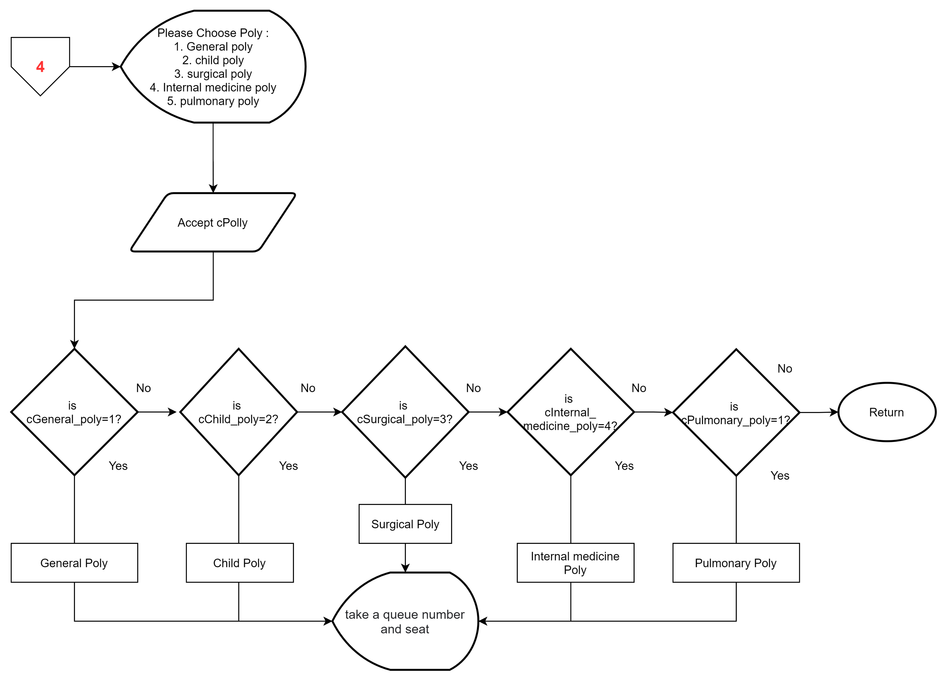
FLOWCHART CHOOSE POLY

Slide 11
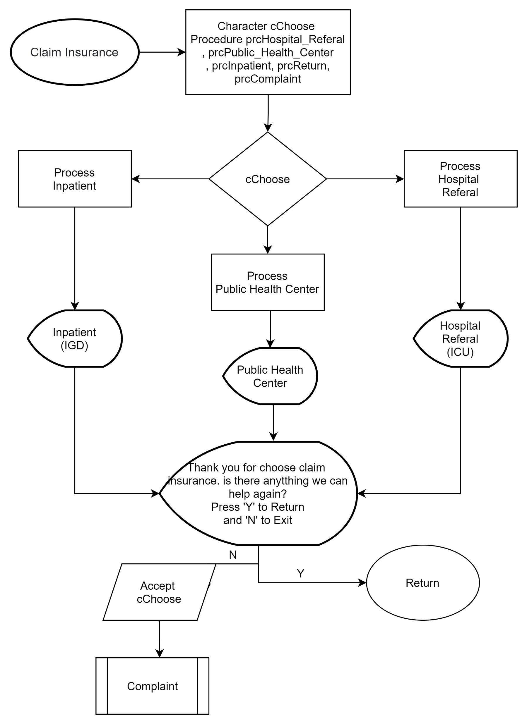
FLOWCHART CLAIM INSURANCE

Slide 12
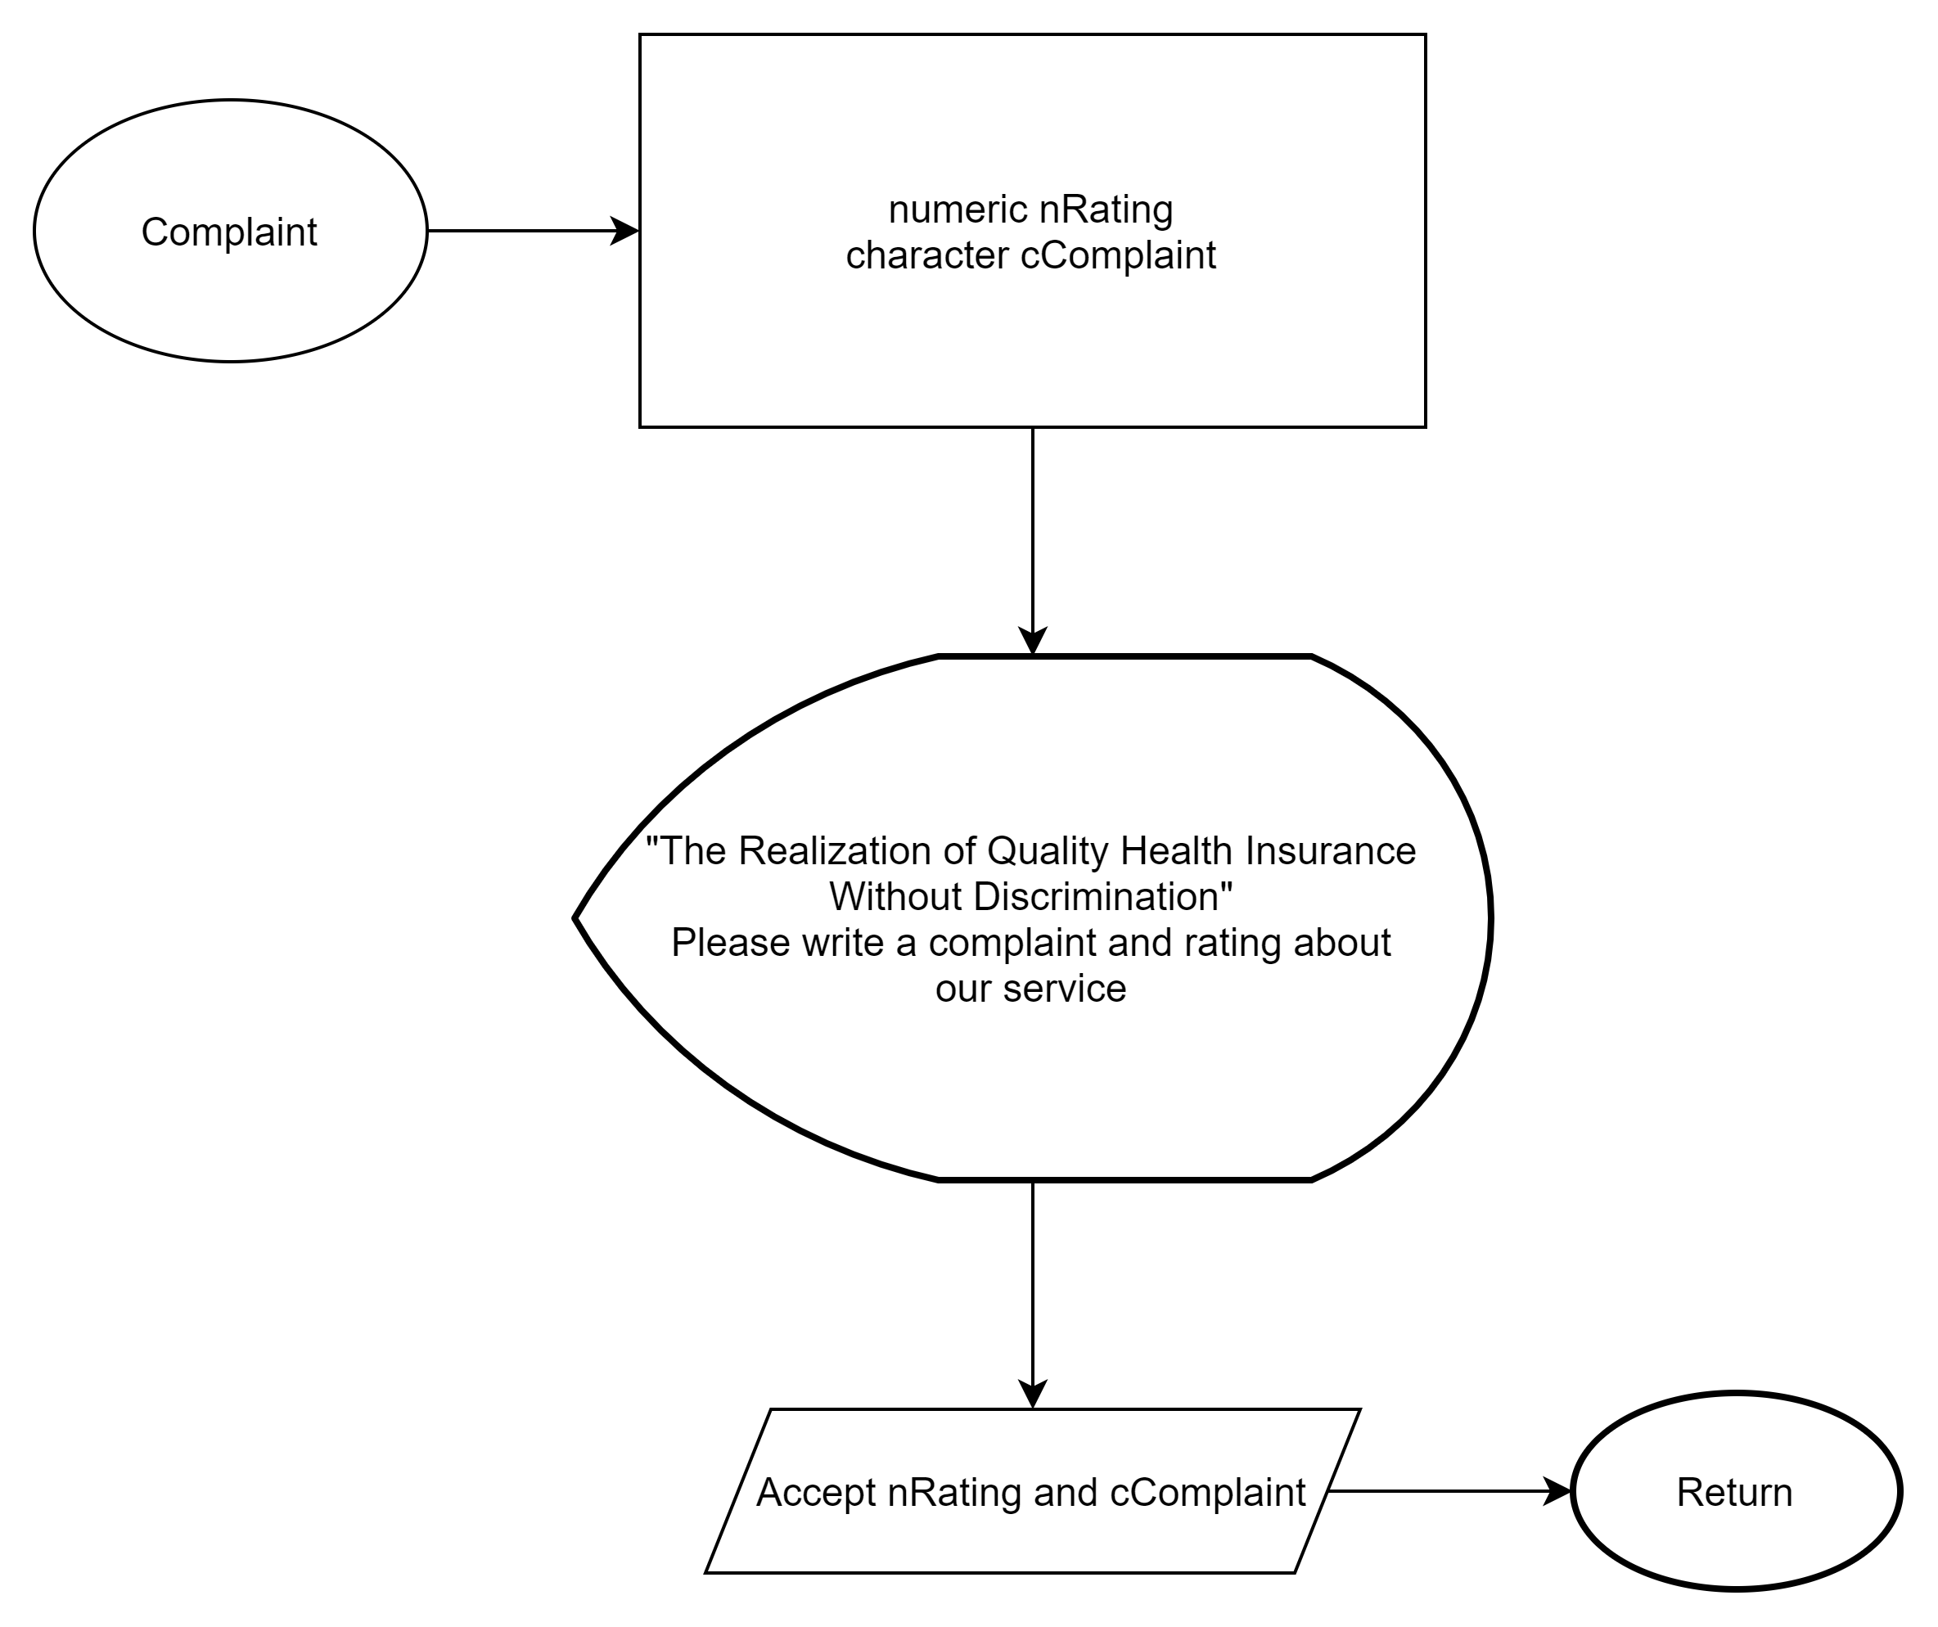
FLOWCHART COMPLAINT

Slide 13
PSEUDOCODE HOME MENU

Slide 14
PSEUDOCODE
REGISTRATION

Slide 15
PSEUDOCODE
PAYMENT METHOD

Slide 16
PSEUDOCODE
PAYMENT METHOD

Slide 17
PSEUDOCODE
CLAIM HEALTH SERVICE

Slide 18
PSEUDOCODE
CLAIM INSURANCE

Slide 19
PSEUDOCODE
COMPLAINT

Slide 20
DRY RUN
nHomeMenu
Initation | Input | Process | Output
nHomeMenu | nHomeMenu | Accept nHomeMenu | Display "BPJS Keshatan Menu 1. Registrarion 2. Payment Method 3. Claim Health Service 4. Complaint"
nMenu | 1 | Call prcRegistration | "Please select 1-4"
 | 2 | Call prcPayment_Method | "Please select 1-4"
 | 3 | Call prcClaim_Health_Service | "Please select 1-4"
 | 4 | Call Complaint | "Please select 1-4"

Slide 21
DRY RUN
Procedure prc_Registration
Initation | Input | Process | Output
cPatient_Registration | prcNew_Patient | Call prcRegistration | Display “Insert your identity 1.Family Card (KK) 2.Active Email and Mobile Number 3.Passport_Visa“
 | cChoose | Call prcNewPatient
cSelect_Class | cSelect_Class | Accept cPatient | Display “Select Class Health Facility 1. Class 1 2. Class 2 3. Class 3”
nSelect_Class | 1 | Call prcClass 1 | Display “ - room capacity 2-4 patient - available upgrade to vvip room (extend cost)” “
 | 2 | Call prcClass 2 | Display - room capacity 3-5 patient - available upgrade to vvip room (extend cost)“
 | 3 | Call prcClass 3 | Display - doctor consultation - medicine - medical material and tools“
 | 4 | Call prcRegistration | prcReturn
cSelect_Class | cSelected_Class | Accept nClass | prcPayment_Method

Slide 22
DRY RUN
prcPayment_Method
Initiation | Input | Process | Output
cPayment_Method | nChoose_Payment | prcPayment | Display “ These are Price for Selected Class Class 1 : Rp. 150.000 Class 2 : Rp. 100.000 Class 3 : Rp. 35.0000 “
nPrice | nPrice | prcPayment | prcTotal_Payment
nTotal_Payment | nPayment | prcAtm_Transfer | Display “ Thank you for your visit to BPJS KESEHATAN, is there anything we can help again? “
 |  | prcAutodebet
 |  | prcSms_Banking
 |  | prcInternet_Banking
 |  | prcKantor_Pos
 |  | prcIndomaret
cComment | Y | Call prcHome_Menu | prcHome_Menu
 | N | prcAccept_Comment | prcHome_Menu

Slide 23
DRY RUN
Procedure prcClaim_Health_Service
Initation | Input | Process | Output
cClaim_Health_Service | cClaim_Health_Service | Accept cChoose | DIsplay “Have You Been Register BPJS or This is first time? Choose 'Y' if you're old patient Choose 'N' if you're first time”
cPatient | Y | Call prcOldPatient | prcChoose_Poly
 | N | Call prcNewPatient | prcRegistration
cChoose_Poly | cChoose_Poly | Accept cPolly | Display “Please Choose Poly : 1. General poly 2. child poly 3. surgical poly 4. Internal medicine poly 5. pulmonary poly”
nChoose_Poly | 1 | Call prcGeneral_Poly | Display “take a queue number and seat”
 | 2 | Call prcChild_Poly
 | 3 | Call prcSurgical_Poly
 | 4 | Call prcInternal_Medicine_Poly
 | 5 | Call prcPulmonary_Poly
 | 6 | Call prcReturn | prcReturn

Slide 24
DRY RUN
Procedure prcClaimInsurance
Initation | Input | Process | Output
nClaim_Insurance | 1 | Call prcProcess_Inpatient | display "Inpatient (IGD)"
 | 2 | Call prcProcess_Public_Health_Center | display "Public Health Center"
 | 3 | Call prcProcess_Hospital_Referal | display "Hospital Referal (ICU)"
nClaim_Insurance | Y | Call prcReturn | prcReturn
 | N | Call prcComplaint | prcComplaint

Slide 25
DRY RUN
Procedure prcComplaint
Initation | Input | Process | Output
CComplaint | nRating | Accept nRating | display "Thank you for choose claim insurance. is there anytthing we can help again? Press 'Y' to back to menu and 'N' to exit"
 | cComplaint | Accept cComplaint | display "Thank you for choose claim insurance. is there anytthing we can help again? Press 'Y' to back to menu and 'N' to exit"

Slide 26

THANK YOU
GROUP 9 PROJECT 2

